Slide 1
Case Study Customer Churn Analysis
By : Umar Farooque
Date : 10/11/2022

Slide 2
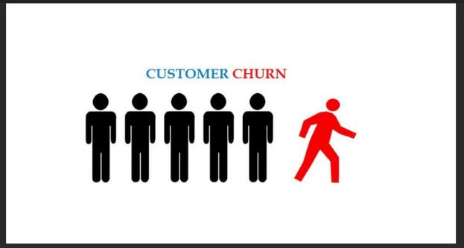
Executive Summary
Customer Churn poses one of the most significant risk to loss revenue. The average churn rate in the telecom industry is about 1.9 % per month.
Since the cost of acquiring new customers is up to 25 times higher than the cost of retaining them, fostering customer loyalty is key.
A new competitor has started stealing customers from the company.

Slide 3
Business Objective
Understand which of the services are not performing well so that product team can improve the quality of service and ensure that existing customers are happy with the services.
Identify which variables are affecting customer churn regarding the existing data from the accounts.
Identify the services that are being received well by the customers so that company can use it to attract new customers.
Identify the High value customers so that company can give them Premium membership in order to retain them.

Slide 4
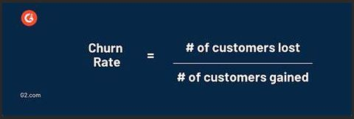
Understanding Customer Churn
Customer Churn is the percentage of customers who have discontinued their subscription to the service in the given period of time.
Why does Customer churn matter?
Less expensive to retain existing customer than to attract new ones.
It helps the competitor in the market to take over you.
Satisfied existing customers are source of brand promotions.
High churn rate is a bigger company problem.

Slide 5
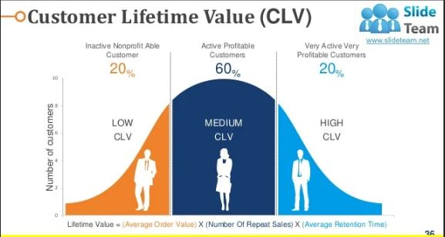
Understanding ‘CLV’
Customer LifeTime Value is the net profit associated with the customer to the company over the fixed period of time.
Higher CLV means :
Higher Return of Investment ‘ROI’ & Less likely to Churn

Slide 6
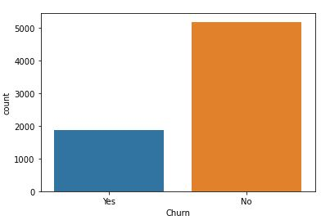
Current Situation
Perform Exploratory Data Analysis
Analysis based on the available account data of customers.
Data Set Description:
Total Observations - 7043
Total Features - 25
26 % of Total Customers Churned

Slide 7
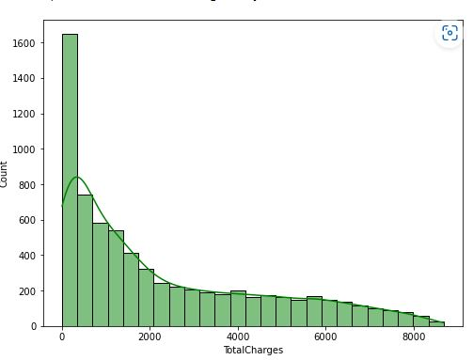
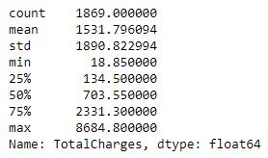
Analysing CLV or LTV
Lifetime value is same as Total Revenue
%ge of Customers - Total Charges
0 < Bottom 80% Cust. < 2800
2800 <Top 20 % Cust. < 8684
Histogram plot for Total Charges
We see from plot that, out of all Customers only the 20% of customers are Paying the 80% of Revenue. High Value Customer : only top 20% of customers. Low Value customer : Rest 80% of customers

Slide 8
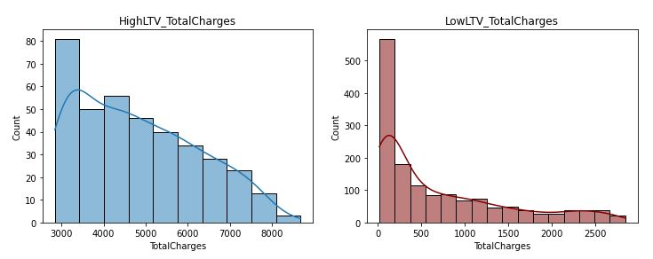
Total Charges Analysis_lowLTV vs highLTV
Out of all Churned customers High Value customers pays avg. Total Charge of 4800 max(8600) Curve shows almost Normal distribution curve
While, Low_value_customers i.e 80 %ile of Customers, most customers have Total Charges less than 500 - Mean 711 (but max 2840) Highly positive skewed..

Slide 9
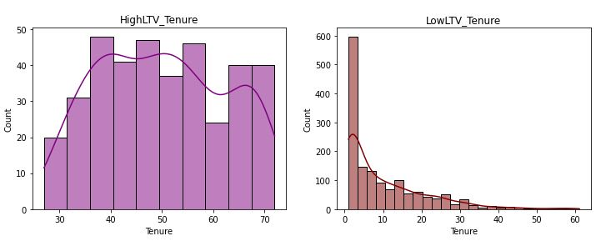
Tenure Analysis_lowLTV vs highLTV
Average LTV of low_value_customers is $711 and their avg.Tenure to stay is around 9 Months.
Average LTV of high_value_customers is $4800 and their avg.Tenure to stay is around 50 Months.
we can conclude that Customers in the top 20% have a much higher tenure and that is the reason for their high lifetime value (LTV). Once again, this suggests that we should focus on serving those 20% customers, who have high LTVs.So to prevent Churning it is Suggested to have Long Tenure Customers as they are less likely to churn.

Slide 10
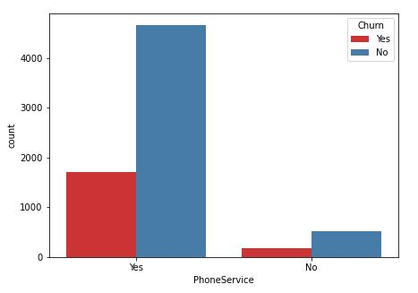
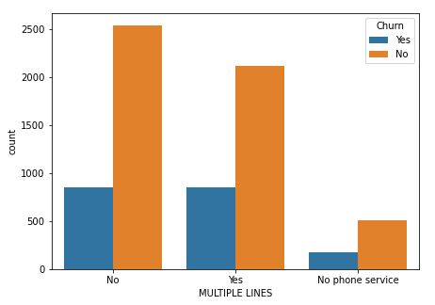
Analysing effect of Services on LTV
Out of the High-LTV customers, only 2% did not use the phone service.
On the other hand, In Low-LTV group, 11% did not use the phone service.
Among the customers in the high-LTV group who used the phone service, 83% used multiple lines. But in the low-LTV group, only 41% used multiple lines.

Slide 11
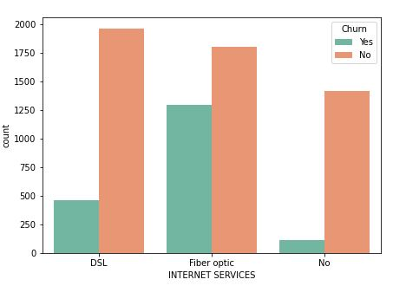
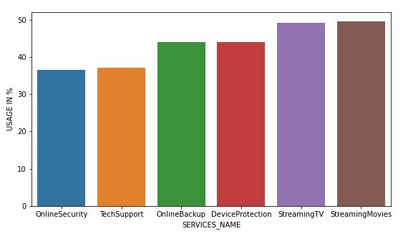
Type Internet Service
Usage Internet Services
Out of Churning Customers who used the internet service , 90% of them used Fiber Optic Connection.
About 80% of the High LTV customers use both streaming movies and streaming TV, which is half for Low LTV.
Fair usage of device protection and online backup by High LTV 55% but low LTV only 22%.

Slide 12
Insights & Solutions concluded from Analysis
Services not performing well :
Internet Services - 21% Customers don’t use Internet Service. (7% Churned + 14% Existing)
By improving Internet Services we can attract existing customers to use Internet Services. Also improved services might reduce Churning.
Variables affecting Churn :
Contract - Churned customers :- Yearly contract (2-8 )%. Month to Month contract(88%) Not Churned - Yearly contract (50-60)%, Month to Month cont.
We conclude that people are less likely to churn if they have a 2-year or a 1-year contract as compared with a month-to-month contract.

Slide 13
Services performing well :
PhoneServices : Around 90% of customers uses Phone Services which is a good sign.
Streaming TV & Streaming Movies : Around 80 % of high LTV customers use both of these services.
We can showcase these Services to attract new customers.
Segmentation of High LTV & Low LTV customers :
Tagging each Churned customers as per their Lifetime value.
Doing so we can target the High LTV customers who are churning & try to retain them.
Because High LTV customers pays Highest REVENUE & retaining existing customer is easier than to acquire new ones.

Slide 14
Assumptions & References
Assumed Customers did not change their Contract during their their tenure.
Assumed the Services Charges were same throughout the Tenure for each Customer.
Dataset used reference : https://www.kaggle.com/blastchar/telco-customer-churn

